Slide 1


Introduction to Parallel Processing in R
By Derek Rucker
July 16th, 2015
https://github.com/derekrucker/RUGS

Slide 2
Things to Know about Parallel Processing
It isn’t especially hard (although there are new and interesting ways to make programming mistakes)
It can speed up certain types of complex computations substantially… but simple computations will actually see a decrease in speed
It doesn’t scale linearly with cores – you may see an asymptotic reduction in benefit as more cores are added. The 2nd core will improve computational speed far more than the 16th core.
It doesn’t work for every problem
You are limited by number of cores AND amount of memory

Slide 3
Types of Parallel Processing
Implicit Intrinsic
Easiest
Multicore processing supported by an existing package, and needs only be enabled by user
Most notable example is the ‘caret’ package
Explicit Intrinsic
Harder
Multicore processing is explicitly defined in the code by the user
Extrinsic
Hardest, and not covered in this presentation
Multiple cores on multiple machines (physical or virtual) are used
Halfway to Hadoop ☺
http://cran.r-project.org/web/views/HighPerformanceComputing.html

Slide 4

Libraries Needed for this Presentation
‘caret’ – convenient model training wrapper and intrinsic multicore package. Pretty much ubiquitous around the R community.
‘foreach’ – multicore loop tool
‘doParallel’ and/or ‘doMC’ – allows ‘foreach’ and ‘caret’ to use their multicore capability. Otherwise you’re stuck in first gear.
‘randomForest’ – used for multicore processing demonstration. Many other computationally intensive packages would work just as well.

Slide 5






doMC or doParallel ?
The parallel processing package needed for R depends upon your user environment.
Linux and Unix based environments (yes, this includes Apple OS) should use doMC
Windows users (like me) should use doParallel
They work pretty much the same, with slightly different register calls, as we will see on the next page
<- doParallel
doMC ->

Slide 6

makeCluster & register
To be able to access parallel processing, it is necessary to create a cluster of cores (processors), and then to “register” them:
NOTE:
You can’t register more cores than you physically have, unless you are working through VMware or some other virtualized front-end. Even then, it doesn’t help processing speed… it just might not throw an error.
When you are done with the parallel processing part of your code, it is good practice (although not strictly speaking required) to stop your cluster (inverse of register):
…or registerDoMC, if appropriate

Slide 7
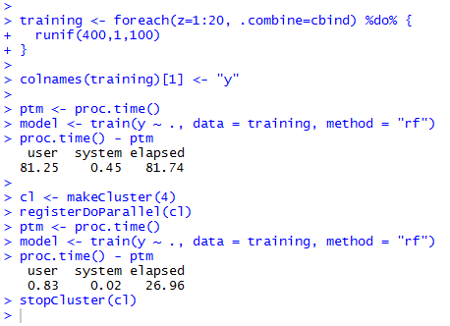
caret Example
Let’s take a look at training a random forest model from a dataset of 8000 elements
Running this without multicore processing on my laptop takes 81.74 seconds
Using all 4 cores, however, takes 26.96 seconds
NOTE:
4 * 26.96 != 81.74
Multicore processing does not divide your processing time by a factor of the number of cores. It may get close, but it will always be less
https://github.com/derekrucker/RUGS

Slide 8
Common Issue
When using caret:
Cause: You have enabled multicore processing… but either not provided a cluster of cores to use, or shut down your cluster using stopCluster. Caret is confused. This can be solved either by restarting and not loading the parallel library (single-core solution), or by registering a cluster (multicore solution):

Slide 9
Explicit Intrinsic - foreach
But suppose that you can’t find an existing package that both does what you want and has multicore enabled? (pretty common)
In this case you have to actually code it yourself
Fortunately, this isn’t as hard as it may seem
The package ‘foreach’ allows multicore looping, and is an easy way to get started
Kinda like a ‘for’ loop, but not exactly…

Slide 10
Explicit Intrinsic Best Practices
Always choose the outside (largest) loop as the unit to parallel process
Turn off your cluster when you are done using it
Test on a small dataset
Decide ahead of time whether you want the results of the multicore call to be appended as columns or rows in the output matrix (.combine=cbind or .combine=rbind)
Remember… packages don’t automatically get sent to the workers. You need to make sure that each core has the libraries required to complete the requested computations (.packages=‘xxxxxx’, or require(xxxxxx))

Slide 11
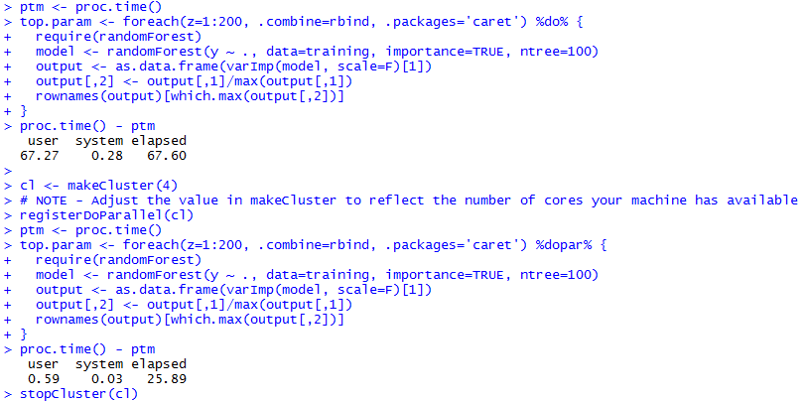
foreach Example
Let’s take a look at getting variable importance information from a random forest model, trained from a dataset with 8000 elements
Without multicore = 67.6 seconds
With 4X multicore = 25.89 seconds
But is that the whole story?
Note: this requires two packages be available to each worker (core): caret and randomForest. One (caret) is specified in ‘.packages’, and the other (randomForest) is specified in ‘require’. These two methods of providing packages to the workers are interchangeable.
https://github.com/derekrucker/RUGS

Slide 12
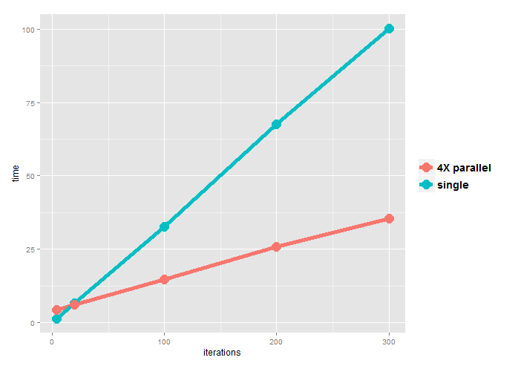
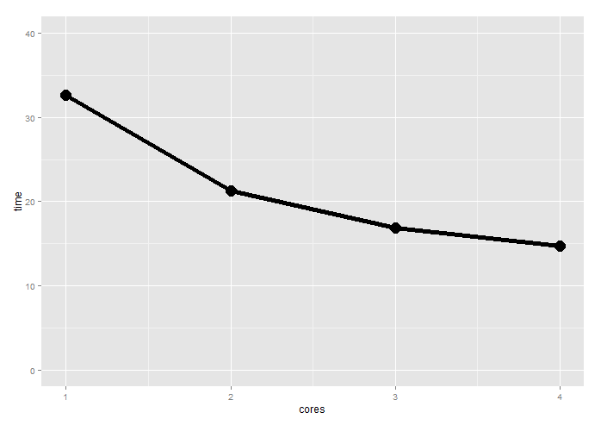
foreach speed
Using parallel processing costs some time up front, and thus there are no efficiency gains for low numbers of iterations
However, after about 20 iterations, the parallel processing path begins to be more efficient, and this accelerates with larger computational needs
Increasing cores improves speed, but not linearly
Make sure you time your code to see if parallel processing is a benefit for your specific use case
@100X iterations

Slide 13
Questions?

